Slide 1


Building a Custom AI Agent and How ColdFusion Can Interact With It
Presented by: Monte Chan

Slide 2

Who is Monte Chan?
Senior ColdFusion Developer at CF Webtools
Has used ColdFusion since version 4.5 back in 1999
Has developed web applications which were used in different industries (ex. Health insurance, education, finTech, e-commerce…etc.)
Was one of the co-managers of Alamo ColdFusion User Group
Has a youTube channel, Geek Talk. https://www.youtube.com/@geektalk2004
On different social media platforms but mostly on Facebook. You can find me on Facebook at https://www.facebook.com/monte.chan/
You can email me at monte@monteandjanicechan.com but you may get a quicker response if you send me a message in Facebook Messenger.

Slide 3
Before we begin…
A version of my presentation will be made available in my youTube channel. There will be more details covered in the youTube version.
The presentation slides will be uploaded to my Github account at https://github.com/knittingguy
CF Codes: https://github.com/knittingguy/aiagent_cf
JavaScript/TypeScript Codes: https://github.com/knittingguy/mongoDB-langchain

Slide 4
Most AI related codes are done in Python because the Machine Learning and the AI technology started in the Python world.
Web developers may not naturally have Python in their skill set.
AI agent -- Autonomous – decision making without constant human intervention
Langchain
  Framework for chaining LLMs with tools, retrievers, and external data sources.
  Help you get a quick start if you are experimenting with different models, RAG pipelines, or prompts
  Open source

Slide 5
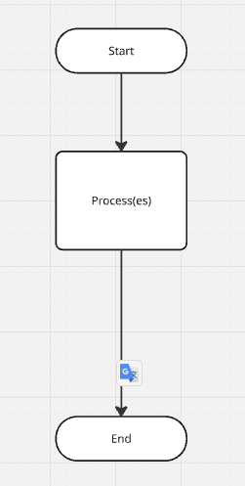

Slide 6
Langgraph –
  framework built on top of Langchain.
  Can handle more complex tasks.
  Creating AI agents/Compound AI systems. The agent can have multiple agents.

Slide 7
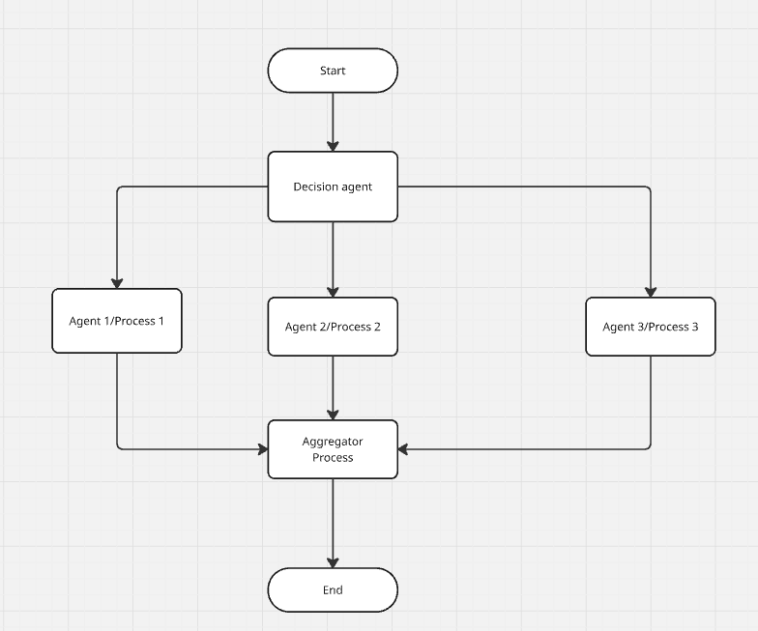

Slide 8
LLM (Large Language Model)
  Regardless how frequently it is trained, at any given moment, the data is not available from the time it was last trained to the time that you are using the LLM.
  It ONLY knows the data being trained on. It has no idea what YOUR data is.
  Hallucination often comes when an LLM does not have enough information or does not have the necessary data to return the correct information.
  RAG – Retrieval-Augmented Generation can help reduce the hallucination. It is often done by referencing an authoritative knowledge base outside of its training data sources before generating a response (using a vector database, calling API, …etc.)

Slide 9
What you need for this example?
Node.js and npm
Vector DB – MongoDB Atlas
https://docs.langchain.com/oss/javascript/integrations/vectorstores
OpenAI API Key
Anthropic API Key
ColdFusion

Slide 10
npm init -y
npm i -D typescript ts-node @types/express @types/node
npx tsc --init
npm install langchain @langchain/langgraph @langchain/mongodb @langchain/langgraph-checkpoint-mongodb @langchain/anthropic dotenv express mongodb zod

Slide 11
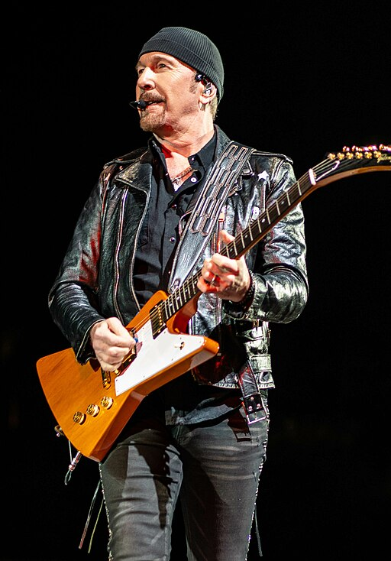

Slide 12
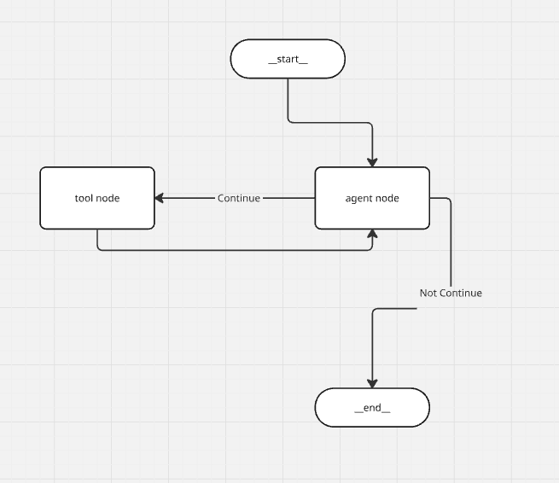

Slide 13
Resources
Langgraph Studio: https://docs.langchain.com/langgraph-platform/quick-start-studio
Langchain: https://www.langchain.com/
MongoDB: https://www.mongodb.com/
LanggraphJS: https://langchain-ai.github.io/langgraphjs/
Vector Stores: https://docs.langchain.com/oss/javascript/integrations/vectorstores#mongodb

Slide 14
Questions?
Presented by: Monte Chan

